Slide 1
Dynamic programming
History does not occur again

Slide 2
6.1 Introduction
Fibonacci number F(n)
1 if n = 0 or 1
F(n-1) + F(n-2) if n > 1
F(n) =
n | 0 | 1 | 2 | 3 | 4 | 5 | 6 | 7 | 8 | 9 | 10
F(n) | 1 | 1 | 2 | 3 | 5 | 8 | 13 | 21 | 34 | 55 | 89
Pseudo code for the recursive algorithm:
F(n)
1 if n=0 or n=1 then return 1
2 else return F(n-1) + F(n-2)

Slide 3
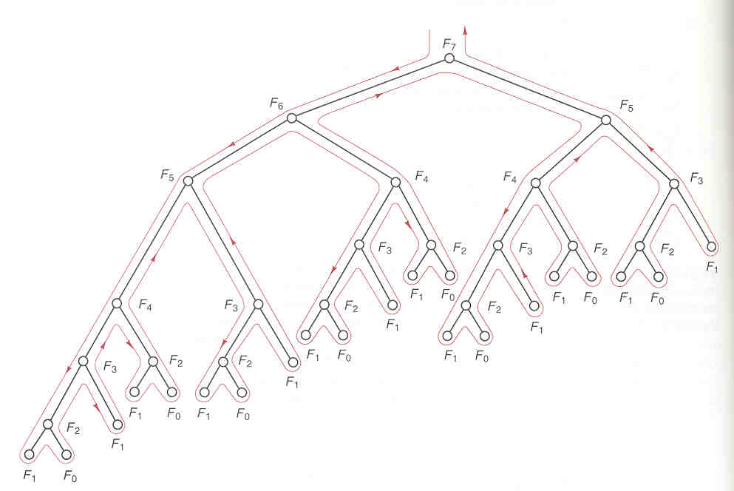
The execution of F(7)
F₇
F₆
F₅
F₅
F₄
F₄
F₃
F₃
F₂
F₃
F₂
F₂
F₁
F₄
F₃
F₂
F₁
F₀
F₂
F₁
F₀
F₁
F₀
F₁
F₁
F₃
F₂
F₂
F₁
F₀
F₁
F₀
F₁
F₁
F₀
F₁
F₀
F₂
F₁
F₁
F₀

Slide 4
The execution of F(7)
F₇
F₆
F₅
F₅
F₄
F₄
F₃
F₃
F₂
F₃
F₂
F₂
F₁
F₄
F₃
F₂
F₁
F₀
F₂
F₁
F₀
F₁
F₀
F₁
F₁
F₃
F₂
F₂
F₁
F₀
F₁
F₀
F₁
F₁
F₀
F₁
F₀
Computation of F(2) is repeated 8 times!
F₂
F₁
F₁
F₀

Slide 5
The execution of F(7)
F₇
F₆
F₅
F₅
F₄
F₄
F₃
F₃
F₂
F₃
F₂
F₂
F₁
F₄
F₃
F₂
F₁
F₀
F₂
F₁
F₀
F₁
F₀
F₁
F₁
F₃
F₂
F₂
F₁
F₀
F₁
F₀
F₁
F₁
F₀
F₁
F₀
Computation of F(3) is also repeated 5 times!
F₂
F₁
F₁
F₀

Slide 6
The execution of F(7)
F₇
F₆
F₅
F₅
F₄
F₄
F₃
F₃
F₂
F₃
F₂
F₂
F₁
F₄
F₃
F₂
F₁
F₀
F₂
F₁
F₀
F₁
F₀
F₁
F₁
F₃
F₂
F₂
F₁
F₀
F₁
F₀
F₁
Many computations are repeated!!
How to avoid this?
F₁
F₀
F₁
F₀
F₂
F₁
F₁
F₀

Slide 7
Idea for improvement
Memorization
Store F1(i) somewhere after we have computed its value
Afterward, we don’t need to re-compute F1(i); we can retrieve its value from our memory.
F1(n)
1 if v[n] < 0 then
2 v[n] ←F1(n-1)+F1(n-2)
3 return v[n]
Main()
1 v[0] = v[1] ←1
2 for i ← 2 to n do
3 v[i] = -1
4 output F1(n)

Slide 8
Look at the execution of F(7)
F(i)=F_{i}
F₇
F₆
F₅
v[0]
v[1]
v[2]
v[3]
v[4]
v[5]
v[6]
v[7]
1
1
-1
-1
-1
-1
-1
-1
F₅
F₄
F₄
F₃
F₃
F₂
F₃
F₂
F₂
F₁
F₄
F₃
F₂
F₁
F₀
F₂
F₁
F₀
F₁
F₀
F₁
F₁
F₂
F₂
F₁
F₀
F₁
F₀
F₃
F₁
F₁
F₀
F₁
F₀
F₂
F₁
F₁
F₀

Slide 9
Look at the execution of F(7)
F₇
F₆
F₅
v[0]
v[1]
v[2]
v[3]
v[4]
v[5]
v[6]
v[7]
1
1
-1
-1
-1
-1
-1
-1
F₅
F₄
F₄
F₃
F₃
F₂
F₃
F₂
F₂
F₁
F₄
F₃
F₂
F₁
F₀
F₂
F₁
F₀
F₁
F₀
F₁
F₁
F₂
F₂
F₁
F₀
F₁
F₀
F₃
F₁
F₁
F₀
F₁
F₀
F₂
F₁
F₁
F₀

Slide 10
Look at the execution of F(7)
F₇
F₆
F₅
v[0]
v[1]
v[2]
v[3]
v[4]
v[5]
v[6]
v[7]
1
1
2
-1
-1
-1
-1
-1
F₅
F₄
F₄
F₃
F₃
F₂
F₃
F₂
F₂
F₁
F₄
F₃
F₂
F₁
F₀
F₂
F₁
F₀
F₁
F₀
F₁
F₁
F₂
F₂
F₁
F₀
F₁
F₀
F₃
F₁
F₁
F₀
F₁
F₀
F₂
F₁
F₁
F₀

Slide 11
Look at the execution of F(7)
F₇
F₆
F₅
v[0]
v[1]
v[2]
v[3]
v[4]
v[5]
v[6]
v[7]
1
1
2
-1
-1
-1
-1
-1
F₅
F₄
F₄
F₃
F₃
F₂
F₃
F₂
F₂
F₁
F₄
F₃
F₂
F₁
F₀
F₂
F₁
F₀
F₁
F₀
F₁
F₁
F₂
F₂
F₁
F₀
F₁
F₀
F₃
F₁
F₁
F₀
F₁
F₀
F₂
F₁
F₁
F₀

Slide 12
Look at the execution of F(7)
F₇
F₆
F₅
v[0]
v[1]
v[2]
v[3]
v[4]
v[5]
v[6]
v[7]
1
1
2
3
-1
-1
-1
-1
F₅
F₄
F₄
F₃
F₃
F₂
F₃
F₂
F₂
F₁
F₄
F₃
F₂
F₁
F₀
F₂
F₁
F₀
F₁
F₀
F₁
F₁
F₂
F₂
F₁
F₀
F₁
F₀
F₃
F₁
F₁
F₀
F₁
F₀
F₂
F₁
F₁
F₀

Slide 13
Look at the execution of F(7)
F₇
F₆
F₅
v[0]
v[1]
v[2]
v[3]
v[4]
v[5]
v[6]
v[7]
1
1
2
3
-1
-1
-1
-1
F₅
F₄
F₄
F₃
F₃
F₂
F₃
F₂
F₂
F₁
F₄
F₃
F₂
F₁
F₀
F₂
F₁
F₀
F₁
F₀
F₁
F₁
F₂
F₂
F₁
F₀
F₁
F₀
F₃
F₁
F₁
F₀
F₁
F₀
F₂
F₁
F₁
F₀

Slide 14
Look at the execution of F(7)
F₇
F₆
F₅
v[0]
v[1]
v[2]
v[3]
v[4]
v[5]
v[6]
v[7]
1
1
2
3
5
-1
-1
-1
F₅
F₄
F₄
F₃
F₃
F₂
F₃
F₂
F₂
F₁
F₄
F₃
F₂
F₁
F₀
F₂
F₁
F₀
F₁
F₀
F₁
F₁
F₂
F₂
F₁
F₀
F₁
F₀
F₃
F₁
F₁
F₀
F₁
F₀
F₂
F₁
F₁
F₀

Slide 15
Look at the execution of F(7)
F₇
F₆
F₅
v[0]
v[1]
v[2]
v[3]
v[4]
v[5]
v[6]
v[7]
1
1
2
3
5
-1
-1
-1
F₅
F₄
F₄
F₃
F₃
F₂
F₃
F₂
F₂
F₁
F₄
F₃
F₂
F₁
F₀
F₂
F₁
F₀
F₁
F₀
F₁
F₁
F₂
F₂
F₁
F₀
F₁
F₀
F₃
F₁
F₁
F₀
F₁
F₀
F₂
F₁
F₁
F₀

Slide 16
Look at the execution of F(7)
F₇
F₆
F₅
v[0]
v[1]
v[2]
v[3]
v[4]
v[5]
v[6]
v[7]
1
1
2
3
5
8
-1
-1
F₅
F₄
F₄
F₃
F₃
F₂
F₃
F₂
F₂
F₁
F₄
F₃
F₂
F₁
F₀
F₂
F₁
F₀
F₁
F₀
F₁
F₁
F₂
F₂
F₁
F₀
F₁
F₀
F₃
F₁
F₁
F₀
F₁
F₀
F₂
F₁
F₁
F₀

Slide 17
Look at the execution of F(7)
F₇
F₆
F₅
v[0]
v[1]
v[2]
v[3]
v[4]
v[5]
v[6]
v[7]
1
1
2
3
5
8
-1
-1
F₅
F₄
F₄
F₃
F₃
F₂
F₃
F₂
F₂
F₁
F₄
F₃
F₂
F₁
F₀
F₂
F₁
F₀
F₁
F₀
F₁
F₁
F₂
F₂
F₁
F₀
F₁
F₀
F₃
F₁
F₁
F₀
F₁
F₀
F₂
F₁
F₁
F₀

Slide 18
Look at the execution of F(7)
F₇
F₆
F₅
v[0]
v[1]
v[2]
v[3]
v[4]
v[5]
v[6]
v[7]
1
1
2
3
5
8
13
-1
F₅
F₄
F₄
F₃
F₃
F₂
F₃
F₂
F₂
F₁
F₄
F₃
F₂
F₁
F₀
F₂
F₁
F₀
F₁
F₀
F₁
F₁
F₂
F₂
F₁
F₀
F₁
F₀
F₃
F₁
F₁
F₀
F₁
F₀
F₂
F₁
F₁
F₀

Slide 19
Look at the execution of F(7)
F₇
F₆
F₅
v[0]
v[1]
v[2]
v[3]
v[4]
v[5]
v[6]
v[7]
1
1
2
3
5
8
13
-1
F₅
F₄
F₄
F₃
F₃
F₂
F₃
F₂
F₂
F₁
F₄
F₃
F₂
F₁
F₀
F₂
F₁
F₀
F₁
F₀
F₁
F₁
F₂
F₂
F₁
F₀
F₁
F₀
F₃
F₁
F₁
F₀
F₁
F₀
F₂
F₁
F₁
F₀

Slide 20
Look at the execution of F(7)
F₇
F₆
F₅
v[0]
v[1]
v[2]
v[3]
v[4]
v[5]
v[6]
v[7]
1
1
2
3
5
8
13
21
F₅
F₄
F₄
F₃
F₃
F₂
F₃
F₂
F₂
F₁
F₄
F₃
F₂
F₁
F₀
F₂
F₁
F₀
F₁
F₀
F₁
F₁
F₂
F₂
F₁
F₀
F₁
F₀
F₃
F₁
F₁
F₀
F₁
F₀
F₂
F₁
F₁
F₀

Slide 21
Can we do even better?
Observation
  The 2nd version still make many function calls, and each wastes times in parameters passing, dynamic linking, ...
  In general, to compute F(i), we need F(i-1) & F(i-2) only
Idea to further improve
  Compute the values in bottom-up fashion.
  That is, compute F(2) (we already know F(0)=F(1)=1), then F(3), then F(4)…
F2(n)
1 F[0] ← 1
2 F[1] ← 1
3 for i ← 2 to n do
4 F[i] ← F[i-1] + F[i-2]
5 return F[n]
This new implementation saves lots of overhead.

Slide 22
Recursive vs Dynamic programming
Too
Slow!
Recursive version:
F(n)
1 if n=0 or n=1 then return 1
2 else return F(n-1) + F(n-2)
Dynamic Programming version:
F2(n)
1 F[0] ← 1
2 F[1] ← 1
3 for i ← 2 to n do
4 F[i] ← F[i-1] + F[i-2]
5 return F[n]
Efficient!
Time complexity is O(n)

Slide 23
Summary of the methodology
Write down a formula that relates a solution of a problem with those of sub-problems.
E.g. F(n) = F(n-1) + F(n-2).
Index the sub-problems so that they can be stored and retrieved easily in a table (i.e., array)
Fill the table in some bottom-up manner; start filling the solution of the smallest problem.
  This ensures that when we solve a particular sub-problem, the solutions of all the smaller sub-problems that it depends are available.
For historical reasons, we call such methodology
Dynamic Programming.
In the late 40’s (when computers were rare),
programming refers to the "tabular method".

Slide 24
6.2 Dynamic programming
Divide-and-conquer method
1. Subproblem is independent.
2. Subproblem is solved repeatedly.
Dynamic programming (DP)
1. Subproblem is not independent.
2. Subproblem is just solved once.
Common: Problem is partitioned into one or more subproblem, then the solution of subproblem is combined.
DP reduces computation by
  Solving subproblems in a bottom-up fashion.
  Storing solution to a subproblem the first time it is solved.
  Looking up the solution when subproblem is met again.
Key: determine structure of optimal solutions

Slide 25
The development of a dynamic-programming algorithm can be broken into a sequence of four steps.
1. Characterize the structure of an optimal solution.
2. Recursively define the value of an optimal solution.
3. Compute the value of an optimal solution in a bottom-up fashion.
4. Construct an optimal solution from computed information.

Slide 26
6.2 Assembly-line scheduling
Problem:
There are two assembly lines, each with n stations; the jth station on line i is denoted S_{i}[j] and the assembly time at that station is a_{i}[j]. An automobile chassis (汽车底盘) enters the factory, and goes onto line i (i = 1 or 2), taking e_{i} time. After going through the jth station on a line, the chassis goes on to the (j + 1)st station on either line. There is no transfer cost if it stays on the same line, but it takes time t_{i}[j] to transfer to the other line after station S_{i}[j]. After exiting the nth station on a line, it takes x_{i} time for the completed auto to exit the factory. The problem is to determine which stations to choose from line 1 and which to choose from line 2 in order to minimize the total time through the factory for one auto.

Slide 27
S_{i}[j] :The jth station on line i ( i=1 or 2) .
a_{i}[j] :The assembly time required at station S_{i}[j].
e_{i} :Entry time.
x_{i}: Exit time.
S₁[1]
S₁[2]
S₁[3]
S₁[n-1]
S₁[n]
Line 1
a₁[1]
a₁[2]
a₁[3]
a₁[n-1]
a₁[n]
e₁
t₁[n-1]
x₁
t₁[1]
t₁[2]
Begin
…
End
t₂[1]
t₂[2]
t₂[n-1]
x₂
e₂
Line 2
a₂[1]
a₂[2]
a₂[3]
a₂[n-1]
a₂[n]
S₂[1]
S₂[2]
S₂[3]
S₂[n-1]
S₂[n]

Slide 28
One Solution
Brute force
  Enumerate all possibilities of selecting stations
  Compute how long it takes in each case and choose the best one
Problem:
  There are 2^{n} possible ways to choose stations
  Infeasible when n is large
1
2
3
4
n
1
0
0
1
1
0 if choosing line 2
at step j (= 3)
1 if choosing line 1
at step j (= n)

Slide 29
1. Structure of the Optimal Solution
Let’s consider the fastest way possible to get from the starting point through station S₁[j]
  If j = 1: determine how long it takes to get through S₁[1]
  If j ≥ 2, have two choices of how to get to S₁[j]:
    Through S₁[j-1], then directly to S₁[j]
    Through S₂[j-1], then transfer over to S₁[j]
Suppose that the fastest way through S₁[j] is through S₁[j-1]
  We must have taken a fastest way from entry through S₁[j-1]
  If there were a faster way through S₁[j-1], we would use it instead
Similarly for S₂[j-1]

Slide 30
Optimal Substructure
Generalization: an optimal solution to the problem find the fastest way through S₁[j] contains within it an optimal solution to subproblems: find the fastest way through S₁[j-1]or S₂[j-1].
This is referred to as the optimal substructure property
Optimal substructure property is one of the hallmarks of the applicability of dynamic programming.
We use this property to construct an optimal solution to a problem from optimal solutions to subproblems

Slide 31
2. A Recursive Solution (cont.)
f_{i}[j] = the fastest time to get from the starting point through station S_{i}[j]
Let f * denote fastest time to get a chassis all the way through the factory.
j = 1 (getting through station 1)
f₁[1] = e₁ + a₁[1]
f₂[1] = e₂ + a₂[1]
f * = min{ f₁[n]+x₁ , f₂[n]+x₂ }

Slide 32
2. A Recursive Solution (cont.)
Compute f_{i}[j] for j = 2, 3, …,n, and i = 1, 2
Fastest way through S₁[j] is either:
  fastest way through S₁[j-1]then directly through S₁[j], or f₁[j] = f₁[j - 1] + a₁[j]
  fastest way through S₂[j-1], transfer from line 2 to line 1, then through S₁[j]
f₁[j] = f₂[j -1] + t₂[j-1] + a₁[j]
f₁[j] = min(f₁[j - 1] + a₁[j], f₂[j -1] + t₂[j-1] + a₁[j])
S₁[j-1]
S₁[j]
a₁[j-1]
a₁[j-1]
t₂[j-1]
a₂[j-1]
S₂[j-1]

Slide 33
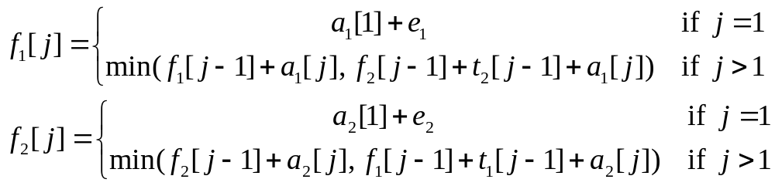
The recursive equation
For example, n=5:
Solving top-down would result in exponential running time
1
2
3
4
5
f₁[j]
f₁[1]
f₁[2]
f₁[3]
f₁[4]
f₁[5]
f₂[j]
f₂[1]
f₂[2]
f₂[3]
f₂[4]
f₂[5]
4 times
2 times

Slide 34
3. Computing the Optimal Solution
For j ≥ 2, each value f_{i}[j] depends only on the values of f₁[j – 1] and f₂[j - 1]
Compute the values of f_{i}[j]
  in increasing order of j
Bottom-up approach
  First find optimal solutions to subproblems
  Find an optimal solution to the problem from the subproblems
increasing j
1
2
3
4
5
f₁[j]
f₂[j]

Slide 35
Additional Information
To construct the optimal solution we need the sequence of what line has been used at each station:
  l_{i}[j] – the line number (1, 2) whose station (j - 1) has been used to get in fastest time through S_{i}[j], j = 2, 3, …, n
  l* - the line whose station n is used to get in the fastest way through the entire factory
increasing j
2
3
4
5
l₁[j]
l₂[j]

Slide 36
Step 3: Computing the fastest way
DPFastestWay(a, t, e, x, n)
1 f₁[1] ← e₁ + a₁[1]; f₂[1] ←e₂ + a₂[1]
2 for j ← 2 to n do
3 if f₁[j - 1] + a₁[j] ≤ f₂ [j - 1] + t₂[j-1] + a₁[j] then
4 f₁[j] ← f₁[j - 1] + a₁[j]
5 l₁[j] ← 1
6 else f₁[j] ← f₂ [j - 1] + t₂[j-1] + a₁[j]
7 l₁[j] ← 2
8 if f₂[j - 1] + a₂[j]≤ f₁[j - 1] + t₁[j-1] + a₂[j] then
9 f₂[j] ← f₂[j - 1] + a₂[j]
10 l₂[j] ← 2
11 else f₂ [j] ← f₁[j - 1] + t₁[j-1]+ a₂[j] then
12 l₂[j] ← 1
13 if f₁[n] + x1≤f₂[n] + x₂ then
14 f* ← f₁[n] + x₁
15 l* ← 1
16 else f* ← f₂[n] + x₂
17 l*← 2
Running time: Θ(n)

Slide 37
For example
7
9
3
4
8
4
2
2
3
1
3
4
3
Begin
End
4
2
1
2
2
1
2
8
5
6
4
5
7
j
1
2
3
4
5
6
j
2
3
4
5
6
f₁[j]
9
18
20
24
32
35
l₁[j]
1
2
1
1
2
f₂[j]
12
16
22
25
30
37
l₂[j]
1
2
1
2
2
f *=38
l *=1

Slide 38
4. Construct an Optimal Solution
PrintStations(l, n)
1 i ← l*
2 print “line ” i “, station ” n
3 for j ← n downto 2 do
4 i ←l_{i}[j]
5 print “line ” i “, station ” j - 1
line 1, station 6
line 2, station 5
line 2, station 4
line 1, station 3
line 2, station 2
line 1, station 1
j
2
3
4
5
6
l₁[j]
1
2
1
1
2
l *=1
l₂[j]
1
2
1
2
2

Slide 39
The fastest assembly way
f *=38
7
9
3
4
8
4
2
2
3
1
3
4
3
Begin
End
2
1
2
2
1
2
4
8
5
6
4
5
7

Slide 40
6.3 Matrix-chain multiplication
Problem:
Given a chain A₁, A₂, . . . , A_{n} of n matrices, where for i = 1, 2, . . . , n , matrix A_{i} has dimension p_{i-1} × p_{i}, fully parenthesize the product A₁ A₂...A_{n} in a way that minimizes the number of scalar multiplications.
A₁ ⋅ A₂ ⋅⋅⋅ A_{i} ⋅ A_{i+1} ⋅⋅⋅ A_{n}
p₀ × p₁ p₁ × p₂ p_{i-1} × p_{i} p_{i} × p_{i+1} p_{n-1} × p_{n}
A product of matrices is fully parenthesized if it is either a single matrix or the product of two fully parenthesized matrix products, surrounded by parentheses.

Slide 41
For example, if the chain of matrices is <A₁, A₂, A₃, A₄>, the product A₁ A₂ A₃ A₄ can be fully parenthesized in five distinct ways:
(A₁ (A₂ (A₃ A₄))) ,
(A₁ ((A₂ A₃) A₄)) ,
((A₁ A₂) (A₃ A₄)) ,
((A₁ (A₂ A₃)) A₄) ,
(((A₁ A₂) A₃) A₄).

Slide 42
MatrixMultiply(A,B)
1 if m≠p then
2 print “Two matrices cannot multiply"
3 else for i←1 to n
4 for j←1 to q do
5 C[i, j]←0
6 for k ←1 to m do
7 C[i ,j]←C[i ,j] + A[i, k] B[k, j]
8 return C
Running time: Θ(nmq)

Slide 43
Consider the problem of a chain A₁, A₂, A₃ of three matrices. Suppose that the dimensions of the matrices are 10×100, 100×5, and 5×50, respectively.
1. ((A₁A₂) A₃): A₁A₂ = 10×100×5 = 5,000 (10×5)
((A₁ A₂) A₃) = 10×5×50 = 2,500
Total: 7,500 scalar multiplications
2. (A₁ (A₂A₃)): A₂A₃ = 100×5×50 = 25,000 (100×50)
(A₁ (A₂ A₃)) = 10×100×50 = 50,000
Total: 75,000 scalar multiplications
one order of magnitude difference!!

Slide 44
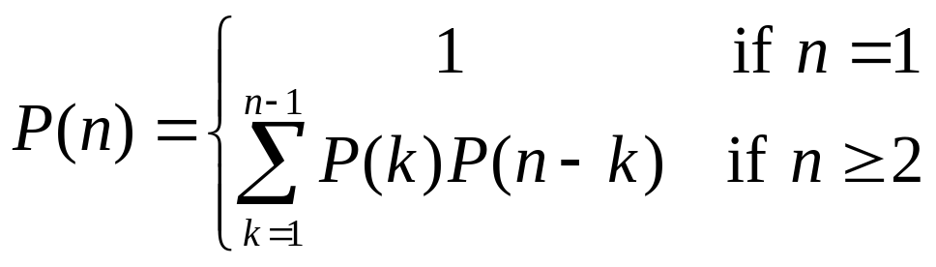
Counting the number of parenthesizations
Denote the number of alternative parenthesizations of a sequence of n matrices by P(n). Since we can split a sequence of n matrices between the kth and (k + 1)st matrices for any k = 1, 2, . . . , n -1 and then parenthesize the two resulting subsequences independently, we obtain the recurrence
The solution to the above recurrence is Ω(2^{n}).

Slide 45
1. The structure of an optimal parenthesization
Notation:
A_{i…j} = A_{i} A_{i+1} ⋅⋅⋅ A_{j}, i ≤ j
For i < j:
A_{i…j} = A_{i} A_{i+1} ⋅⋅⋅ A_{j}
= A_{i} A_{i+1} ⋅⋅⋅ A_{k} A_{k+1} ⋅⋅⋅ A_{j}
= A_{i…k} A_{k+1…j}
Suppose that an optimal parenthesization of A_{i…j} splits the product between A_{k} and A_{k+1}, where i ≤ k < j
A_{i…j} = A_{i…k} A_{k+1…j}

Slide 46
Optimal substructure
A_{i…j} = A_{i…k} A_{k+1…j}
The parenthesization of the “prefix” A_{i…k} must be an optimal parentesization
If there were a less costly way to parenthesize A_{i…k}, we could substitute that one in the parenthesization of A_{i…j} and produce a parenthesization with a lower cost than the optimum ⇒ contradiction!
An optimal solution to an instance of the matrix-chain multiplication contains within it optimal solutions to subproblems

Slide 47
2. A recursive solution
Subproblem:
determine the minimum cost of parenthesizing A_{i…j} = A_{i} A_{i+1} ⋅⋅⋅ A_{j} for 1 ≤ i ≤ j ≤ n
Let m[i, j] = the minimum number of multiplications needed to compute A_{i…j}
  Full problem (A_{1..n}): m[1, n]

Slide 48
2. A Recursive Solution (cont.)
Define m recursively:
  i = j: A_{i…i} = A_{i} ⇒ m[i, i] = 0, for i = 1, 2, …, n
  i < j: assume that the optimal parenthesization splits the product A_{i} A_{i+1} ⋅⋅⋅ A_{j} between A_{k} and A_{k+1}, i ≤ k < j:
  A_{i…j} = A_{i…k} A_{k+1…j}
  m[i, j] = m[i, k] + m[k+1, j] + p_{i-1}p_{k}p_{j}
A_{i…k}
A_{k+1…j}
A_{i…k}A_{k+1…j}

Slide 49
2. A Recursive Solution (cont.)
Consider the subproblem of parenthesizing A_{i…j} = A_{i} A_{i+1} ⋅⋅⋅ A_{j} for 1 ≤ i ≤ j ≤ n
= A_{i…k} A_{k+1…j} for i ≤ k < j
m[i, j] = the minimum number of multiplications needed to compute the product A_{i…j}
  m[i, j] = m[i, k] + m[k+1, j] + p_{i-1}p_{k}p_{j}
p_{i-1}p_{k}p_{j}
m[i, k]
m[k+1,j]
min # of multiplications
to compute A_{i…k}
min # of multiplications
to compute A_{k+1…j}
# of multiplications
to compute A_{i…k}A_{k…j}

Slide 50
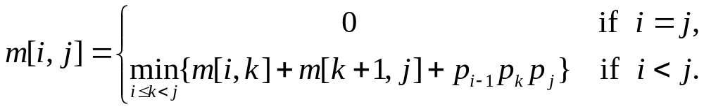
2. A Recursive Solution (cont.)
  m[i, j] = m[i, k] + m[k+1, j] + p_{i-1}p_{k} p_{j}
We do not know the value of k
  There are j–i possible values for k: k = i, i+1, …, j-1
Minimizing the cost of parenthesizing the product A_{i} A_{i+1} ⋅⋅⋅ A_{j} becomes:

Slide 51
Reconstructing the Optimal Solution
Additional information to maintain:
s[i, j] = a value of k at which we can split the product A_{i} A_{i+1} ⋅⋅⋅ A_{j} in order to obtain an optimal parenthesization

Slide 52
3. Computing the Optimal Costs
How many subproblems do we have?
  Parenthesize A_{i…j} for 1 ≤ i ≤ j ≤ n
  One problem for each choice of i and j
A recurrent algorithm may encounter each subproblem many times in different branches of the recursion ⇒ overlapping subproblems
Compute a solution using a tabular bottom-up approach
⇒ Θ(n²)

Slide 53
3. Computing the Optimal Costs (cont.)
How do we fill in the tables m[1..n, 1..n] and s[1..n, 1..n] ?
  Determine which entries of the table are used in computing m[i, j]
  m[i, j] = cost of computing a product of j – i – 1 matrices
  m[i, j] depends only on costs for products of fewer than j – i – 1 matrices
  A_{i…j} = A_{i…k} A_{k+1…j}
  Fill in m such that it corresponds to solving problems of increasing length

Slide 54
3. Computing the Optimal Costs (cont.)
Length = 0: i = j, i = 1, 2, …, n
Length = 1: j = i + 1, i = 1, 2, …, n-1
second
first
1
2
3
n
n
m[1, n] gives the optimal
solution to the problem
j
Compute rows from bottom to top and from left to right
In a similar matrix s we keep the optimal values of k
3
2
1
i

Slide 55
MatrixChainOrder(p)
DPMatrixChain(p)
1 for i ← 1 to n do
2 m[i, i] ← 0
3 for c ← 2 to n do
4 for i ← 1 to n – c + 1 do
5 j ← i +c – 1
6 m[i, j] ← ∞
7 for k ← i to j – 1 do
8 q ← m[i, k] + m[k+1, j] + p_{i-1}p_{k}p_{j}
9 if q < m[i, j] then
10 m[i, j] ← q; s[i, j] ← k
11 return m and s
Running time: Θ(n³)

Slide 56
Example: min {m[i, k] + m[k+1, j] + p_{i-1} p_{k} p_{j}}
m[2, 2] + m[3, 5] + p₁p₂p₅
m[2, 3] + m[4, 5] + p₁p₃p₅
m[2, 4] + m[5, 5] + p₁p₄p₅
k = 2
m[2, 5] = min
k = 3
k = 4
1
2
3
4
5
6
6
5
Values m[i, j] depend only on values that have been previously computed
4
j
3
2
1
i

Slide 57
Example: Compute A₁A₂A₃
1
2
3
A₁: 10×100 (p₀×p₁)
A₂: 100×5 (p₁×p₂)
A₃: 5×50 (p₂×p₃)
m[i, i] = 0 for i = 1, 2, 3
m[1, 2] = m[1, 1] + m[2, 2] + p₀p₁p₂ (A₁A₂)
= 0 + 0 + 10×100×5 = 5,000
m[2, 3] = m[2, 2] + m[3, 3] + p₁p₂p₃ (A₂A₃)
= 0 + 0 + 100×5×50 = 25,000
m[1,1] + m[2,3] + p₀p₁p₃ = 75,000 (A₁(A₂A₃))
m[1,2] +m[3, 3] + p₀p₂p₃ = 7,500 ((A₁A₂)A₃)
3
2
2
7500
25000
0
2
1
5000
0
1
0
m[1,3] = min

Slide 58
4. Construct the Optimal Solution
Store the optimal choice made at each subproblem
s[i, j] = a value of k such that an optimal parenthesization of A_{i..j} splits the product between A_{k} and A_{k+1}
s[1, n] is associated with the entire product A_{1..n}
  The final matrix multiplication will be split at k = s[1,n]
  A_{1..n} = A_{1..s[1, n]} ⋅ A_{s[1, n]+1..n}
  For each subproduct recursively find the corresponding value of k that results in an optimal parenthesization

Slide 59
4. Construct the Optimal Solution (cont.)
s[i, j] = value of k such that the optimal parenthesization of A_{i} A_{i+1} ⋅⋅⋅ A_{j} splits the product between A_{k} and A_{k+1}
1
2
3
4
5
6
  A_{1..n} = A_{1..s[1, n]} ⋅ A_{s[1, n]+1..n}
6
3 | 3 | 3 | 5 | 5 | -
3 | 3 | 3 | 4 | -
3 | 3 | 3 | -
1 | 2 | -
1 | -
-
5
s[1,n]=3 ⇒ A_{1..6} = A_{1..3} A_{4..6}
s[1,3]=1 ⇒ A_{1..3} = A_{1..1} A_{2..3}
s[4,6]=5 ⇒ A_{4..6} = A_{4..5} A_{6..6}
4
3
j
2
1
i

Slide 60
4. Construct the Optimal Solution (cont.)
1
2
3
4
5
6
PrintParens(s, i, j)
1 if i = j then print “A”_{i}
2 else print “(”
3 PrintParens(s, i, s[i, j])
4 PrintParens(s, s[i, j] + 1, j)
5 print “)”
6
3 | 3 | 3 | 5 | 5 | -
3 | 3 | 3 | 4 | -
3 | 3 | 3 | -
1 | 2 | -
1 | -
-
5
4
3
2
j
1
i

Slide 61
Example: A₁⋅ ⋅ ⋅A₆
(
(
A₁
(
A₂
A₃
)
)
((A₄A₅)A₆))
s[1..6, 1..6]
1
2
3
4
5
6
PrintOPTParens(s, i, j)
1 if i = j then print “A”_{i}
2 else print “(”
3 PrintOPTParens(s, i, s[i, j])
4 PrintOPTParens(s, s[i, j] + 1, j)
5 print “)”
6
3 | 3 | 3 | 5 | 5 | -
3 | 3 | 3 | 4 | -
3 | 3 | 3 | -
1 | 2 | -
1 | -
-
5
4
j
3
2
1
POP(s, 1, 6) s[1, 6] = 3
i = 1, j = 6 “(“ POP (s, 1, 3) s[1, 3] = 1
i = 1, j = 3 “(“ POP(s, 1, 1) ⇒ “A₁”
POP(s, 2, 3) s[2, 3] = 2
i = 2, j = 3 “(“ POP (s, 2, 2) ⇒ “A₂”
POP (s, 3, 3) ⇒ “A₃”
“)”
“)”
i
…

Slide 62
6.4 The longest-common-subsequence problem
Subsequence
Common subsequence
Maximum-length common subsequence
Problem:Given two sequences X_{m} =< x₁, x₂, ..., x_{m}>and Y_{n} = <y₁, y₂, ..., y_{n}>and wish to find a maximum-length common subsequence of X_{m} and Y_{n} .
E.g.:
X = ⟨A, B, C, B, D, A, B⟩
Subsequences of X:
  A subset of elements in the sequence taken in order
⟨A, B, D⟩, ⟨B, C, D, B⟩, etc.

Slide 63
Example
X = ⟨A, B, C, B, D, A, B⟩ X = ⟨A, B, C, B, D, A, B⟩
Y = ⟨B, D, C, A, B, A⟩ Y = ⟨B, D, C, A, B, A⟩
⟨B, C, B, A⟩ and ⟨B, D, A, B⟩ are longest common subsequences of X and Y (length = 4)
⟨B, C, A⟩, however is not a LCS of X and Y

Slide 64
Brute-Force Solution
For every subsequence of X_{m}, check whether it’s a subsequence of Y_{n}
There are 2^{m} subsequences of X_{m} to check
Each subsequence takes Θ(n) time to check
  Scan Y_{n} for first letter, from there scan for second, and so on
Running time: Θ(n2^{m})

Slide 65
Notations
Given a sequence X_{m} = ⟨x₁, x₂, …, x_{m}⟩ we define the i-th prefix of X_{m} , for i = 0, 1, 2, …, m
X_{i} = ⟨x₁, x₂, …, x_{i}⟩
c[i, j] = the length of a LCS of the sequences X_{i} = ⟨x₁, x₂, …, x_{i}⟩ and Y_{j} = ⟨y₁, y₂, …, y_{j}⟩

Slide 66
Step 1: Optimal substructure
Theorem (Optimal substructure of an LCS)
Let X_{m} =< x₁, x₂, ..., x_{m}>and Y_{n} = <y₁, y₂, ..., y_{n}> be sequences, and let Z_{k} =< z₁, z₂, ..., z_{k}> be any LCS of X_{m} and Y_{n}.
1. If x_{m} = y_{n}, then z_{k} = x_{m} = y_{n} and z_{k-1} is an LCS of X_{m-1} and Y_{n-1}.
2. If x_{m} ≠ y_{n}, and z_{k} ≠ x_{m},then Z_{k} is an LCS of X_{m-1} and Y_{n}.
3. If x_{m}≠ y_{n}, and z_{k} ≠ y_{n} ,then Z_{k} is an LCS of X_{m} and Y_{n-1}.

Slide 67
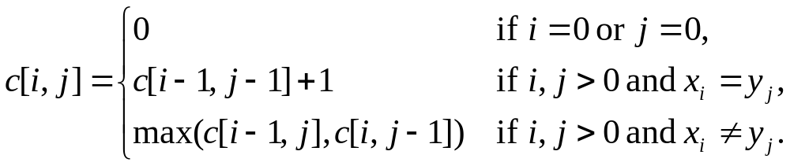
Step 2: A recursive solution
Case 1: x_{i} = y_{j}
e.g.: X_{i} = ⟨A, B, D, E⟩
Y_{j} = ⟨Z, B, E⟩
  Append x_{i} = y_{j} to the LCS of X_{i-1} and Y_{j-1}
  Must find a LCS of X_{i-1} and Y_{j-1} ⇒ optimal solution to a problem includes optimal solutions to subproblems

Slide 68
A Recursive Solution
Case 2: x_{i} ≠ y_{j}
e.g.: X_{i} = ⟨A, B, D, G⟩
Y_{j} = ⟨Z, B, D⟩
  Must solve two problems
    find a LCS of X_{i-1} and Y_{j}: X_{i-1} = ⟨A, B, D⟩ and Y_{j} = ⟨Z, B, D⟩
    find a LCS of X_{i} and Y_{j-1}: X_{i} = ⟨A, B, D, G⟩ and Y_{j} = ⟨Z, B⟩
Optimal solution to a problem includes optimal solutions to subproblems
c[i, j] =
max { c[i - 1, j], c[i, j-1] }

Slide 69
Overlapping Subproblems
To find a LCS of X_{m} and Y_{n}
  We may need to find the LCS between X_{m} and Y_{n-1} and that of X_{m-1} and Y_{n}
  Both the above subproblems has the subproblem of finding the LCS of X_{m-1} and Y_{n-1}
Subproblems share subsubproblems

Slide 70
Step 3: Computing the Length of the LCS
  0 if i = 0 or j = 0
  c[i, j] = c[i-1, j-1] + 1 if x_{i} = y_{j}
  max(c[i, j-1], c[i-1, j]) if x_{i} ≠ y_{j}
0
1
2
n
y_{j:}
y₁
y₂
y_{n}
Y_{j:}
0
x_{i}
0 | 0 | 0 | 0 | 0 | 0
0
0
0
0
0
X_{i}
1
x₁
first
j
2
x₂
second
i
c[i, j]
m
x_{m}

Slide 71
Additional Information
  0 if i, j = 0
c[i, j] = c[i-1, j-1] + 1 if x_{i} = y_{j}
  max(c[i, j-1], c[i-1, j]) if x_{i} ≠ y_{j}
A matrix b[i, j]:
it tells us what choice was made to obtain the optimal value
If x_{i} = y_{j}
b[i, j] = “ ”
Else, if c[i - 1, j] ≥ c[i, j-1]
b[i, j] = “ ↑ ”
else
b[i, j] = “ ← ”
b & c:
0
1
2
3
n
y_{j:}
A
C
D
F
0
x_{i}
0 | 0 | 0 | 0 | 0 | 0
0
0
0
0
0
1
A
2
B
c[i-1,j]
i
3
C
c[i,j-1]
m
D
j

Slide 72
LCSLength(X, Y, m, n)
1 for i ← 1 to m do c[i, 0] ← 0
2 for j ← 0 to n do c[0, j] ← 0
3 for i ← 1 to m do
4 for j ← 1 to n do
5 if x_{i} = y_{j} then
6 c[i, j] ← c[i - 1, j - 1] + 1
7 b[i, j ] ← “↖”
8 else if c[i - 1, j] ≥ c[i, j - 1] then
9 c[i, j] ← c[i - 1, j]
10 b[i, j] ← “↑”
11 else c[i, j] ← c[i, j - 1]
12 b[i, j] ← “←”
13 return c and b
Running time: Θ(nm)

Slide 73
Example
  0 if i = 0 or j = 0
  c[i, j] = c[i-1, j-1] + 1 if x_{i} = y_{j}
  max(c[i, j-1], c[i-1, j]) if x_{i} ≠ y_{j}
X = ⟨B, D, C, A, B, A⟩
Y = ⟨A, B, C, B, D, A⟩
if x_{i} = y_{j} then
b[i, j] = “ ”
else if c[i - 1, j]≥c[i, j-1] then
b[i, j] = “ ↑ ”
else
b[i, j] = “ ← ”
0
1
2
3
4
5
6
y_{j}
B
D
C
A
B
A
0
x_{i}
0
0
0
0
0
0
0
1
A
0
↑
0
↑
0
↑
0
1
1
←1
2
B
0
1
↑
1
2
←1
←1
←2
3
C
0
↑
1
↑
1
2
↑
2
↑
2
←2
4
B
0
1
↑
1
↑
2
↑
2
3
←3
5
D
0
↑
1
2
↑
2
↑
2
↑
3
↑
3
6
A
0
↑
1
↑
2
↑
2
3
↑
3
4
7
B
1
↑
2
↑
2
↑
3
4
↑
4
0

Slide 74
4. Constructing a LCS
Start at b[m, n] and follow the arrows
When we encounter a “ “ in b[i, j] ⇒ x_{i} = y_{j} is an element of the LCS
0
1
2
3
4
5
6
y_{j}
B
D
C
A
B
A
0
x_{i}
0
0
0
0
0
0
0
1
A
0
↑
0
↑
0
↑
0
1
1
←1
2
B
0
1
↑
1
2
←1
←1
←2
3
C
0
↑
1
↑
1
2
↑
2
↑
2
←2
4
B
0
1
↑
1
↑
2
↑
2
3
←3
5
D
0
↑
1
2
↑
2
↑
2
↑
3
↑
3
6
A
0
↑
1
↑
2
↑
2
3
↑
3
4
7
B
1
↑
2
↑
2
↑
3
4
↑
4
0

Slide 75
Step 4: Constructing an LCS
PrintLCS(b, X, i, j)
1 if i = 0 or j = 0 then return 0
2 if b[i, j] = " ↖ " then
3 PrintLCS (b, X, i - 1, j - 1)
4 print xi
5 else if b[i, j] = "↑" then
6 PrintLCS(b, X, i - 1, j)
7 else PrintLCS(b, X, i, j - 1)

Slide 76
4. Constructing a LCS
Start at b[m, n] and follow the arrows
When we encounter a “↖“ in b[i, j] ⇒ x_{i} = y_{j} is an element of the LCS
j
0
1
2
3
4
5
6
i
y_{j}
B
D
C
A
B
A
0
x_{i}
0
0
0
0
0
0
0
1
A
0
↑
0
↑
0
↑
0
1
1
←1
2
B
0
1
↑
1
2
←1
←1
←2
3
C
0
↑
1
↑
1
2
↑
2
↑
2
←2
4
B
0
1
↑
1
↑
2
↑
2
3
←3
5
D
0
↑
1
2
↑
2
↑
2
↑
3
↑
3
6
A
0
↑
1
↑
2
↑
2
3
↑
3
4
7
B
0
1
↑
2
↑
2
↑
3
4
↑
4

Slide 77
Improving the Code
What can we say about how each entry c[i, j] is computed?
  It depends only on c[i -1, j - 1], c[i - 1, j], and c[i, j - 1]
  Eliminate table b and compute in O(1) which of the three values was used to compute c[i, j]
  We save Θ(mn) space from table b
  However, we do not asymptotically decrease the auxiliary space requirements: still need table c
If we only need the length of the LCS
  LCSLenght works only on two rows of c at a time
    The row being computed and the previous row
  We can reduce the asymptotic space requirements by storing only these two rows

Slide 78
6.5 0/1 Knapsack Problem
The 0-1 knapsack problem
  A thief rubbing a store finds n items: the i-th item is worth v_{i} dollars and weights w_{i} pounds (v_{i}, w_{i} integers)
  The thief can only carry W pounds in his knapsack
  Items must be taken entirely or left behind
  Which items should the thief take to maximize the value of his load?
The fractional knapsack problem
  Similar to above
  The thief can take fractions of items

Slide 79
The 0-1 Knapsack Problem
Thief has a knapsack of capacity W
There are n items: for i-th item value v_{i} and weight w_{i}
Goal:
  find x_{i} such that for all x_{i} = {0, 1}, i = 1, 2, .., n
  ∑ w_{i}x_{i} ≤ W and
  ∑ x_{i}v_{i} is maximum

Slide 80
Optimal Substructure
Consider the most valuable load that weights at most W pounds
If we remove item j from this load
The remaining load must be the most valuable load weighing at most W – w_{j} that can be taken from the remaining n – 1 items

Slide 81
0-1 Knapsack - Dynamic Programming
V[i, w] – the maximum profit that can be obtained from items 1 to i, if the knapsack has size w
Case 1: thief takes item i
V[i, w] =
Case 2: thief does not take item i
V[i, w] =
v_{i} + V[i - 1, w-w_{i}]
V[i - 1, w]

Slide 82
DPKnapsack(S, W)
1 for w ← 0 to w₁ - 1 do V[1, w] ← 0
2 for w ← w₁ to W do V[1, w] ← v₁
3 for i ← 2 to n do
4 for w ← 0 to W do
5 if w_{i} > w then
6 V[i, w] ← V[i-1, w]
7 b[i, w] ← "↑"
8 else if V[i-1, w]> V[i-1, w-w_{i}] + v_{i} then
9 V[i, w] ← V[i-1, w]
10 b[i, w] ← "↑"
11 else
12 V[i, w] ←V[i-1, w-w_{i}] + v_{i}
13 b[i, w] ← "↖"
14 return V and b
Running time: Θ(nW)

Slide 83
0-1 Knapsack - Dynamic Programming
Item i was taken
Item i was not taken
V[i, w] = max {v_{i} + V[i - 1, w-w_{i}], V[i - 1, w]}
0:
1
w - w_{i}
w
W
0
0 | 0 | 0 | 0 | 0 | 0 | 0 | 0 | 0 | 0 | 0
0
0
0
0
0
0
first
second
i-1
i
n

Slide 84
W = 5
Item i | w_{i} | v_{i}
1 | 2 | 12
2 | 1 | 10
3 | 3 | 20
4 | 2 | 15
例子
V[i, w] = max {v_{i} + V[i - 1, w-w_{i}], V[i - 1, w] }
w
0
1
2
3
4
5
i
0
0 | 0 | 0 | 0 | 0 | 0
0
0
0
0
V[1, 1] =
V[0, 1] = 0
1
0
12
12
12
12
V[1, 2] =
max{12+0, 0} = 12
2
10
12
22
22
22
V[1, 3] =
max{12+0, 0} = 12
3
10
12
22
30
32
V[1, 4] =
max{12+0, 0} = 12
4
10
15
25
30
37
V[1, 5] =
max{12+0, 0} = 12
V[2, 1]=
max{10+0, 0} = 10
V[3, 1]=
V(2,1) = 10
V[4, 1]=
P[3,1] = 10
V[2, 2]=
max{10+0, 12} = 12
V[3, 2]=
V(2,2) = 12
V[4, 2]=
max{15+0, 12} = 15
V[2, 3]=
max{10+12, 12} = 22
V[3, 3]=
max{20+0, 22}=22
V[4, 3]=
max{15+10, 22}=25
V[2, 4]=
V[3, 4]=
max{20+10,22}=30
V[4, 4]=
max{15+12, 30}=30
max{10+12, 12} = 22
V[2, 5]=
max{10+12, 12} = 22
V[4, 5]=
max{20+12,22}=32
V[4, 5]=
max{15+22, 32}=37

Slide 85
Reconstructing the Optimal Solution
0
1
2
3
4
5
0
Item 4
0 | 0 | 0 | 0 | 0 | 0
0
0
0
0
1
0
12
12
12
12
Item 2
2
10
12
22
22
22
3
10
12
22
30
32
Item 1
4
10
15
25
30
37
Start at V[n, W]
When you go left-up ⇒ item i has been taken
When you go straight up ⇒ item i has not been taken

Slide 86
Overlapping Subproblems
V[i, w] = max {v_{i} + V[i - 1, w-w_{i}], V[i - 1, w] }
0:
1
w
W
0
0 | 0 | 0 | 0 | 0 | 0 | 0 | 0 | 0 | 0 | 0
0
0
0
0
0
0
i-1
i
n
E.g.: all the subproblems shown in grey may depend on V[i-1, w]

Slide 87
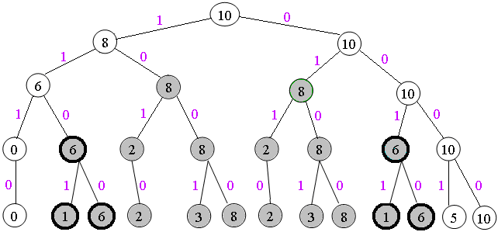
Overlapping Subproblems
E.g.: n=5, v=[6,3,5,4,6], w=[2,2,6,5,4], W=10

Slide 88
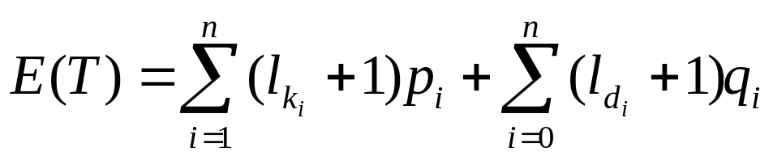
6.6 Optimal binary search trees
Problem
Given a sequence K = <k₁, k₂, ..., k_{n} >of n distinct keys in sorted order (so that k₁ < k₂ ··· < k_{n}), and n + 1 "dummy keys" d₀, d₁, d₂, ..., d_{n},we wish to build a binary search tree from these keys. For each key k_{i}, we have a probability p_{i} that a search will be for k_{i}. For each d_{i}, we have a probability q_{i} that a search will correspond to d_{i}. Let us assume that the actual cost of a search is the number of nodes examined, i.e., the depth of the node found by the search in T, plus 1. Then the expected cost of a search in T is
For a given set of probabilities, our goal is to construct a binary search tree whose E(T) is smallest.

Slide 89
Example
i | 0 | 1 | 2 | 3 | 4 | 5
p_{i} |  | 0.15 | 0.1 | 0.05 | 0.1 | 0.2
q_{i} | 0.05 | 0.1 | 0.05 | 0.05 | 0.05 | 0.1
E(T)= 2.8
k₂
E(T)= 2.75
k₂
k₁
k₅
k₁
k₄
k₄
d₅
d₀
d₁
k₃
k₅
d₀
d₁
k₃
d₄
d₂
d₃
d₄
d₅
d₂
d₃

Slide 90
E(T)=2.8
node | depth | probability | contribution
k₁ | 1 | 0.15 | 0.3
k₂ | 0 | 0.1 | 0.1
k₃ | 2 | 0.05 | 0.15
k₄ | 1 | 0.1 | 0.2
k₅ | 2 | 0.2 | 0.6
d₀ | 2 | 0.05 | 0.15
d₁ | 2 | 0.1 | 0.3
d₂ | 3 | 0.05 | 0.2
d₃ | 3 | 0.05 | 0.2
d₄ | 3 | 0.05 | 0.2
d₅ | 3 | 0.1 | 0.4

Slide 91
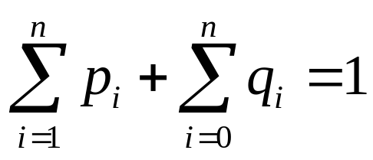
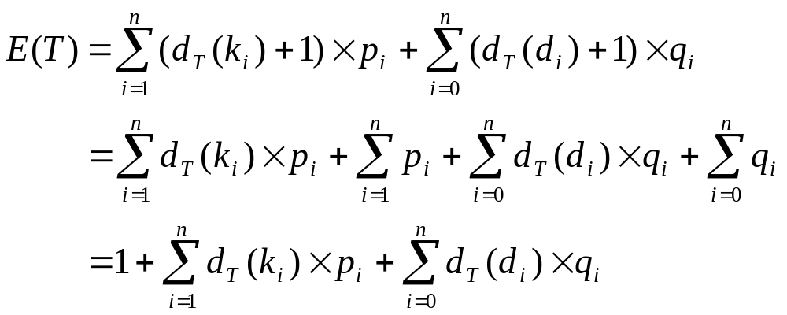
Expected Search Cost

Slide 92
Exhaustive search
For a given set of probabilities, our goal is to construct a binary search tree whose expected search cost is smallest. We call such a tree an optimal binary search tree.
Label the nodes of any n-node binary tree with the keys k₁, k₂, ..., k_{n} to construct a binary search tree, and then add in the dummy keys as leaves.
  For each,
  assign keys and compute expected search cost.
  But there are Ω(4^{n}/n^{3/2}) different BSTs with n nodes.

Slide 93
Step 1: The structure of an optimal binary search tree
Consider any subtree of a binary search tree. It must contain keys in a contiguous(邻近的，连续的) range k_{i}, ..., k_{j}, for some 1≤i≤j≤n. In addition, a subtree that contains keys k_{i}, ..., k_{j} must also have as its leaves the dummy keys d_{i-1}, ..., d_{j}.
Optimal substructure: if an optimal binary search tree T has a subtree T ' containing keys k_{i}, ..., k_{j}, then this subtree T ' must be optimal as well for the subproblem with keys k_{i}, ..., k_{j} and dummy keys d_{i-1}, ..., d_{j}. The usual cut-and-paste argument applies. If there were a subtree T" whose expected cost is lower than that of T ', then we could cut T ' out of T and paste in T", resulting in a binary search tree of lower expected cost than T, thus contradicting the optimality of T.

Slide 94
Optimal Substructure
One of the keys in k_{i}, …,k_{j}, say k_{r}, where i ≤ r ≤ j,
must be the root of an optimal subtree for these keys.
Left subtree of k_{r} contains k_{i},...,k_{r−1}.
Right subtree of k_{r} contains k_{r+1}, ...,k_{j}.
To find an optimal BST:
  Examine all candidate roots k_{r} , for i ≤ r ≤ j
  Determine all optimal BSTs containing k_{i},...,k_{r−1} and containing k_{r+1},...,k_{j}
k_{r}
k_{i}
k_{r-1}
k_{r+1}
k_{j}

Slide 95
Step 2: A recursive solution
Find optimal BST for k_{i},...,k_{j}, where i ≥ 1, j ≤ n, j ≥ i−1. When j = i−1, the tree only contains d_{i-1}.
Define e[i, j ] = expected search cost of optimal BST for k_{i},...,k_{j} and dummy keys d_{i-1}, ..., d_{j.}
If j = i−1, then e[i, j ] = q_{i-1}.
If j ≥ i,
  Select a root k_{r}, for some i ≤ r ≤ j .
  Recursively make an optimal BSTs
    for k_{i},..,k_{r−1} as the left subtree, and
    for k_{r+1},..,k_{j} as the right subtree.

Slide 96
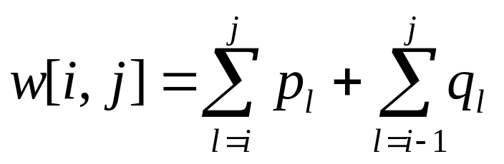
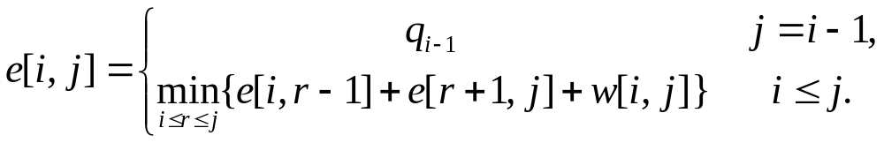
Recursive Solution
When the OPT subtree becomes a subtree of a node:
  Depth of every node in OPT subtree goes up by 1.
  Expected search cost increases by
If k_{r} is the root of an optimal BST for k_{i},..,k_{j} :
  e[i, j ] = p_{r} + (e[i, r−1] + w[i, r−1])+(e[r+1, j] + w[r+1, j])
  = e[i, r−1] + e[r+1, j] + w[i, j].
But, we don’t know k_{r}. Hence,
(because w[i, j]=w[i,r−1] + p_{r} + w[r + 1, j])

Slide 97
Step 3 Computing an Optimal Solution
For each subproblem (i,j), store:
expected search cost in a table e[1 ..n+1 , 0 ..n]
  Will use only entries e[i, j ], where j ≥ i−1.
root[i, j ] = root of subtree with keys k_{i},..,k_{j}, for 1 ≤ i ≤ j ≤ n.
w[1..n+1, 0..n] = sum of probabilities
  w[i, i−1] = q_{i-1} for 1 ≤ i ≤ n.
  w[i, j ] = w[i, j-1] + p_{j}+ q_{j} for 1 ≤ i ≤ j ≤ n.

Slide 98
DPOptimalBST(p, q, n)
1 for i ← 1 to n + 1 do
2 e[i, i− 1] ← q_{i-1}
3 w[i, i− 1] ← q_{i-1}
4 for c ← 1 to n do
5 for i ← 1 to n−c + 1 do
6 j ←i + c−1
7 e[i, j ]←∞
8 w[i, j ] ← w[i, j−1] + p_{j}+q_{j}
9 for r ←i to j do
10 t ← e[i, r−1] + e[r + 1, j ] + w[i, j ]
11 if t < e[i, j ] then
12 e[i, j ] ← t
13 root[i, j ] ←r
14 return e and root
Running time: Θ(n³)

Slide 99
e
w
1
2
3
4
5
6
1
2
3
4
5
6
5
2.75 | 2.0 | 1.3 | 0.9 | 0.5 | 0.1
1.75 | 1.2 | 0.6 | 0.3 | 0.05
1.25 | 0.7 | 0.25 | 0.05
0.9 | 0.4 | 0.05
0.45 | 0.1
0.05
5
2.75 | 2.0 | 1.3 | 0.9 | 0.5 | 0.1
1.75 | 1.2 | 0.6 | 0.3 | 0.05
1.25 | 0.7 | 0.25 | 0.05
0.9 | 0.4 | 0.05
0.45 | 0.1
0.05
4
4
3
3
j
j
2
2
1
1
0
0
i
i
root
1
2
3
4
5
i | 0 | 1 | 2 | 3 | 4 | 5
p_{i} |  | 0.15 | 0.1 | 0.05 | 0.1 | 0.2
q_{i} | 0.05 | 0.1 | 0.05 | 0.05 | 0.05 | 0.1
5
2 | 4 | 5 | 5 | 5
2 | 2 | 4 | 4
2 | 2 | 3
1 | 2
1
4
3
j
2
1
i

Slide 100
6.7 Elements of dynamic programming
Optimal substructure
1. The solution to the problem consists of making a choice. Making this choice leaves one or more subproblems to be solved.
2. For a given problem, you are given the choice that leads to an optimal solution.
3. Given this choice, you determine which subproblems ensue and how to best characterize the resulting space of subproblems.
4. Solutions to the subproblems used within the optimal solution to the problem must themselves be optimal by using a "cut-and-paste" technique.

Slide 101
Optimal substructure varies across problem domains in two ways:
1. how many subproblems are used in an optimal solution to the original problem, and
2. how many choices we have in determining which subproblem(s) to use in an optimal solution.
The running time of a dynamic-programming algorithm depends on the product of two factors:
1.The number of subproblems overall
2. How many choices we look at for eachsubproblem.

Slide 102
Parameters of Optimal Substructure
How many subproblems are used in an optimal solution for the original problem
  Assembly line:
  Matrix multiplication:
How many choices we have in determining which subproblems to use in an optimal solution
  Assembly line:
  Matrix multiplication:
One subproblem (the line that gives best time)
Two subproblems (subproducts A_{i..k}, A_{k+1..j})
Two choices (line 1 or line 2)
j - i choices for k (splitting the product)

Slide 103
Parameters of Optimal Substructure
Intuitively, the running time of a dynamic programming algorithm depends on two factors:
  Number of subproblems overall
  How many choices we look at for each subproblem
Assembly line
  Θ(n) subproblems (n stations)
  2 choices for each subproblem
Matrix multiplication:
  Θ(n²) subproblems (1 ≤ i ≤ j ≤ n)
  At most n-1 choices
Θ(n) overall
Θ(n³) overall

Slide 104
Subtleties
Dynamic programming uses optimal substructure in a bottom-up fashion.
One should be careful not to assume that optimal substructure applies when it does not.
Consider the following two problems in which we are given a directed graph G = (V, E) and vertices u, v ∈V.

Slide 105
Unweighted shortest path: Find a path from u to v consisting of the fewest edges.
Such a path must be simple, since removing a cycle from a path produces a path with fewer edges.
Unweighted longest simple path: Find a simple path from u to v consisting of the most edges.
We need to include the requirement of simplicity because otherwise we can traverse a cycle as many times as we like to create paths with an arbitrarily large number of edges.

Slide 106
u
w
x
v

Slide 107
Overlapping subproblems
1..4
1..1
2..4
1..2
3..4
1..3
4..4
2..2
3..4
2..3
4..4
1..1
2..2
3..3
4..4
1..1
2..3
1..2
3..3
3..3
4..4
2..2
3..3
2..2
3..3
1..1
2..2

Slide 108
Memoization
Top-down approach with the efficiency of typical dynamic programming approach
Maintaining an entry in a table for the solution to each subproblem
When a subproblem is first encountered its solution is computed and stored in that table
Subsequent “calls” to the subproblem simply look up that value

Slide 109
LookUpChain(p, i, j)
1 if m[i, j] < ∞ then return m[i, j]
2 if i = j then
3 m[i, j] ← 0
4 else for k ← i to j - 1 do
5 q←LookUpChain(p, i, k)+LookUpChain(p,k + 1, j) + p_{i-1}p_{k}p_{j}
6 if q < m[i, j] then
7 m[i, j] ← q
8 return m[i, j]
MemoizedMatrixChain(p)
1 for i ← 1 to n do
2 for j ← i to n do
3 m[i, j] ← ∞
4 return LookUpChain(p, 1, n)

Slide 110
Dynamic Progamming vs. Memoization
Advantages of dynamic programming vs. memoized algorithms
  No overhead(费用) for recursion, less overhead for maintaining the table
  The regular pattern of table accesses may be used to reduce time or space requirements
Advantages of memoized algorithms vs. dynamic programming
  Some subproblems do not need to be solved

Slide 111
Homework
Page 92-94
  6.2
  6.3
  6.5
  6.7
  6.9
  6.12
  6.25
  6.26和6.27至少2题

